Slide 1
Database System for a Non-profit Organization
Presented by
Kingsley Osemudiamne

Slide 2
System Requirements
A nonprofit organization depends on a number of different types of persons for its successful operation. The organization is interested in the following attributes for all of these persons: SSN, name, address, city, state, zip, and telephone. Three types of persons are of greatest interest: employees, volunteers, and donors. Employees have only a date hired attribute, and volunteers have only a skill attribute. Donors have only a relationship (named donates) with an item entity type. A donor must have donated one or more items, and an item may have no donors, or one or more donors. There are persons other than employees, volunteers, and donors who are of interest to the organization so that a person need not belong to any of these three groups. On the other hand, at a given time a person may belong to two or more of these groups (e.g., employee and donor).

Slide 3
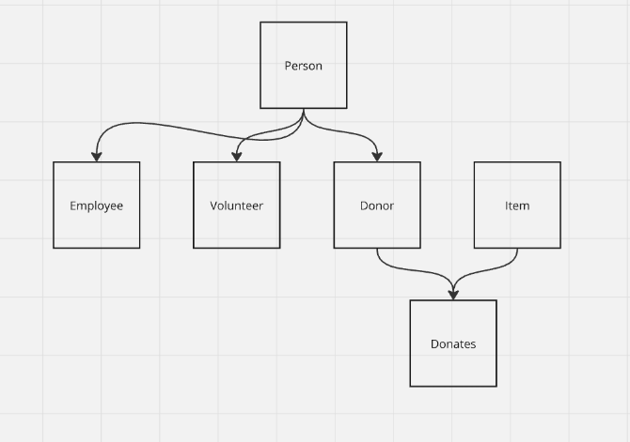
Enhanced Entity Relationship Diagram (EERD)

Slide 4
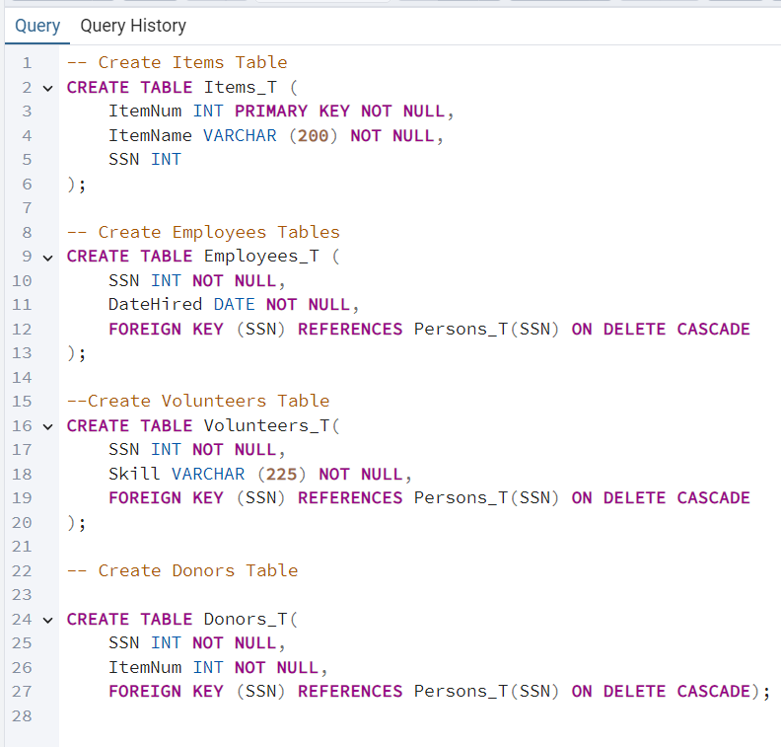
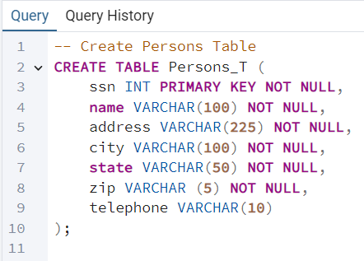
Create Tables using Data Definition (DDL)

Slide 5
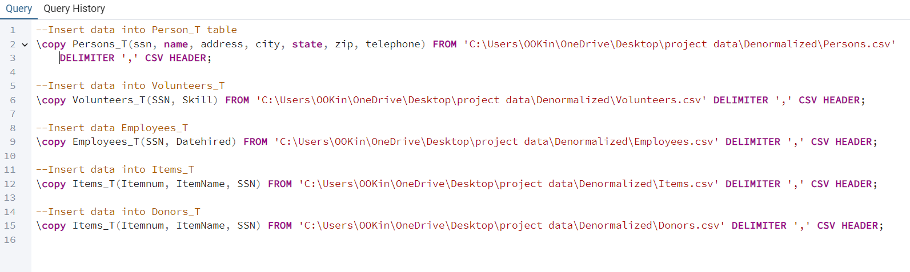
Insert Data Using Data Manipulation Language (DML)

Slide 6
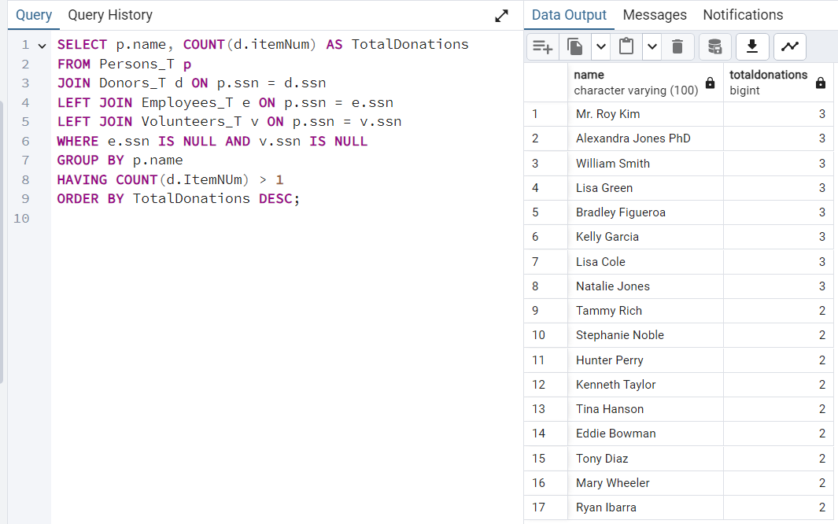
Question1 :- Find all the donors who are neither employees nor volunteers and have donated more than one items

Slide 7
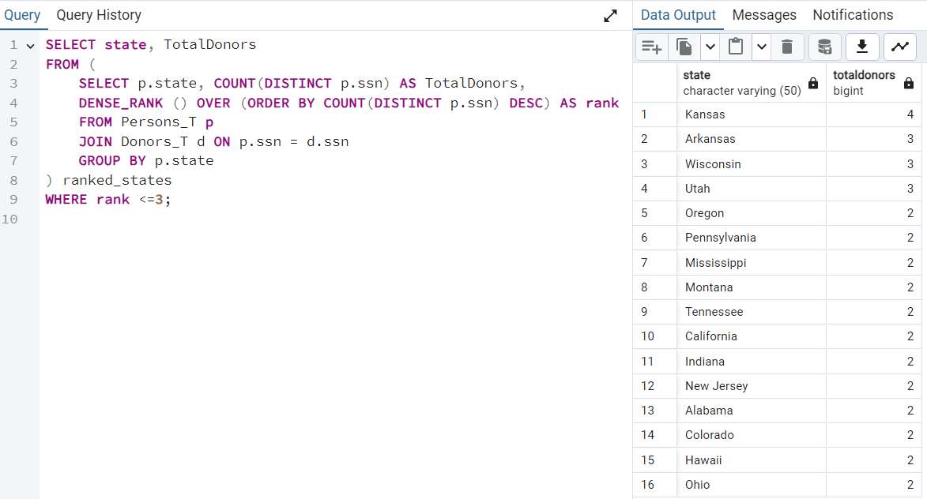
Question 2: - List the top 3 states with the highest number of donors

Slide 8
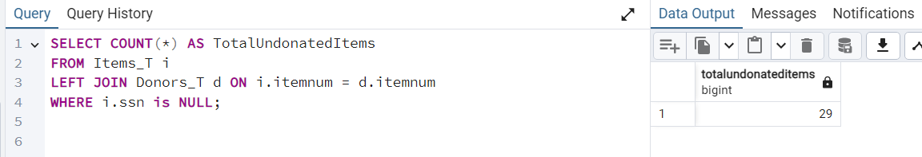
Question 3:- What is the total number of items that were not donated

Slide 9
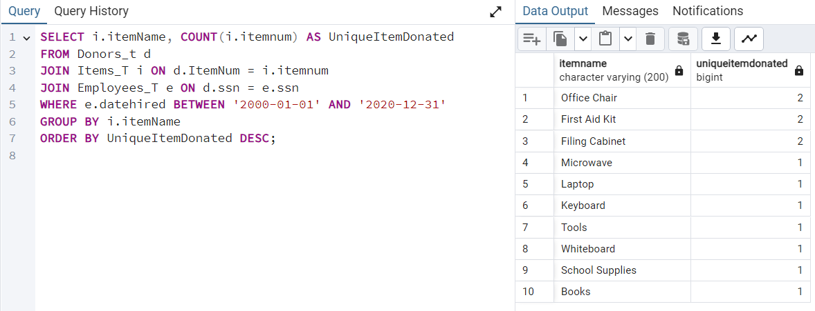
Question 4:- What is the sum of all unique items that were donated by employees hired between 2000 and 2020

Slide 10
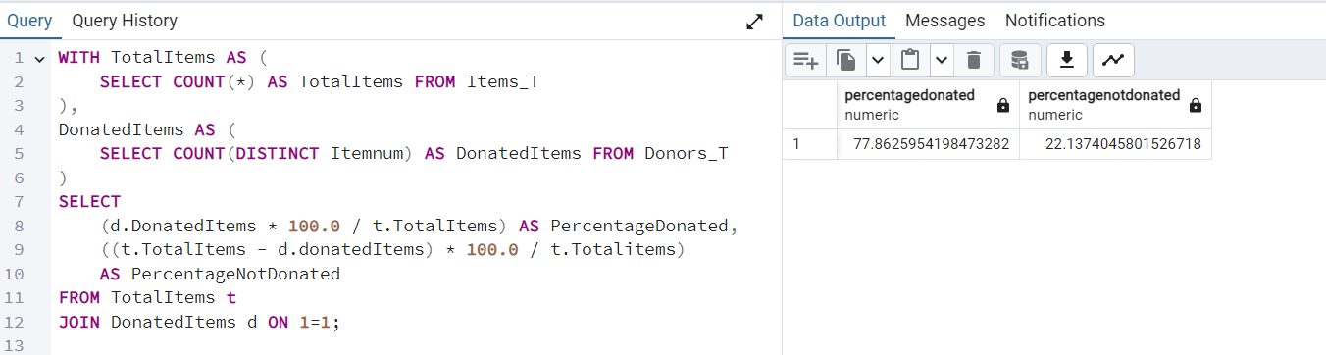
Question 5:- What is the percentage of donated items and undonated items

Slide 11
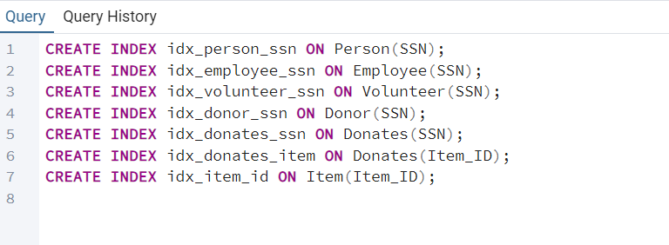
Query Optimization

